Slide 1
Breakout Groups + Take Action
Your Voice is Vital
Tell Your Story
Educate Your Legislators
Notes:
Slide #1 Time: 3 minutes
Talking Points: Welcome the group, Introduce yourself and your connection to WA-SEN; have attendees introduce themselves.

Slide 2
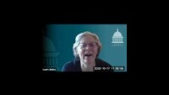
The Importance of Your Story: Speaker Jinkins
Notes:
Slide #2 Time: 5 minutes
Talking Points: We will share with you another clip, from the WA State Speaker of the House, Representative Laurie Jinkins and her presentation at the 2020 Student Summit back in October.

Slide 3
The Importance of Your Story: Speaker Jinkins
We make policy decisions based on your lived experience
Never feel worried about talking to a legislator
We don’t know more than you do
Tell us your stories, it makes a difference
Be open to listening to our experience and where we need help from you
You are leaders, now
Your leadership will determine the future of your community, of Washington State and of our nation
Notes:
Slide #3, Time: 2 minutes
Talking Points: The key points from her talk are included in the bullet points on the slide. Feel free to share any experiences you've had with leg. to add color to these points.

Slide 4
Sharing Your Story
Use the “Sharing Your Story” Worksheet to figure out what you want to say
Things to keep in mind:
How has the Washington College Grant (WCG) helped you or a fellow campus mate?
Why should it be protected?
Notes:
Slide #4, Time: 13 minutes
Talking Points: We will now take some time to work on your story using the “Sharing Your Story Worksheet”. Post this https://wa-sen.org/resources/ in Chat or attach the worksheet to the Chat for students to download and use. This is a fillable PDF.
Emphasize 10 minutes is not nearly enough time to fully craft your story but it is a start. On each page there are boxes with prompts that will get them thinking, each box after the first one builds off the previous question. Once the worksheet is completed, students will have a good start to your story to ready and share with legislators. I’ll be here to answer any questions or if you want to share some ideas together…
Remind students that on page 4 of the worksheet #1 starts on the bottom left of the page and arcs clockwise up, across, and down

Slide 5
Putting it to Practice: Role Play
Facilitator: Keeps meeting on agenda points initiates introduction and agenda
Note-taker: Takes down key points from meeting, notes legislative commitments, keeps note of questions asked
Presenters: Introduce Washington College Grant and provides facts and evidence
Student Testimonials: Gives personal story on the impact of the Washington College Grant (Formerly State Need Grant)
Notes:
Slide #5, Time 2 minutes.
Talking Points: Now that we all have something written down, let’s take some time to practice role playing for your Olympia Days.
Before your regions scheduled Olympia Day you will meet as a group.
Each person will have a role (go over bulleted items) and as you go through different meetings you can choose to stay in the same role or rotate. Please clearly communicate who will take what role BEFORE any meeting. Your regional coordinator or the statewide coordinator for WA-SEN will join you or check in throughout the days scheduled meetings. In some meetings there may be more than one note-taker or your group may chose
We will now go through a run through twice with people playing different roles (you can assign roles or ask for volunteers). Let them know you will play the role of legislator and they will use their stories and talking points provided for the other roles to educate you about the importance of protecting the Washington College Grant.

Slide 6
Role Play
What role would you like to play during your 2021 Olympia Days?
Thursday, February 11 (Virtual South) Friday, February 19 (King North) Thursday, March 11 (Pierce South) Friday, March 12 (Eastern) Monday, March 15 (Virtual North)
Notes:
Slide #6, Time 25 minutes for introduction and role play
Talking Points: After first run through of the role play ask students:
How do you feel the role play went?
What were strengths and what were some areas of growth?
If there is time, repeat the process again and then ask: what role feels better to you? Is there anything you would like to do differently when you meet with your legislations?
Remind student this practice for the Olympia days and remind them of the date. If they are unsure about what region they are in, direct them to the website link. https://wa-sen.org/resources/

Slide 7
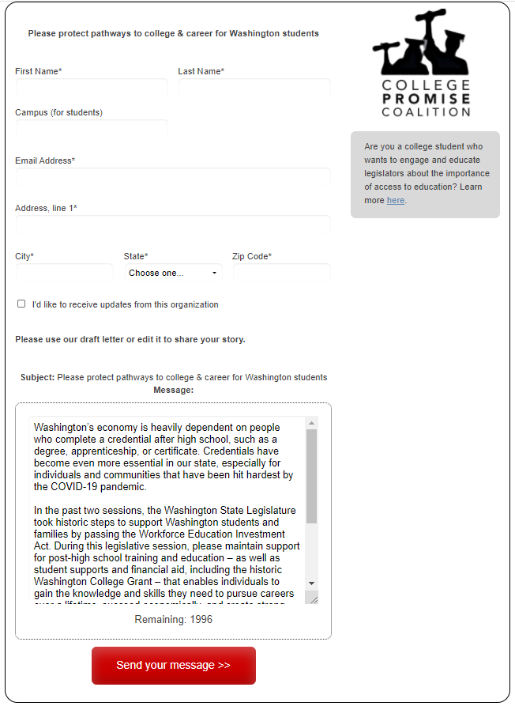
A Call for Action!
Let’s use your what you’ve been working on to write a message to YOUR legislators!
https://collegepromise.salsalabs.org/wacollegegrant/index.html
Notes:
Slide #6, Time: 10 minutes
Talking Points: Now that we’ve got some practice in, let’s share our stories with our legislators.
The College Promise Coalition has created this page to make it easy for constituents to email their legislators. Once you have the page pulled up and you put in your address it pulls up you legislators. You have one senator and two representatives.
The message is ready to go is, or you can personalize it. Consider using what you worked on today to personalize the first sentence or two and the closing. We will spend the next 10 minutes sending these. I will be here to field any questions you have. After this, we’ll be called back to the larger group for the Photo and Video Blitz!
For this letter writing campaign, here’s a quick sentence you can cut and paste to the opening of the letter if easier (put this is the chat):
“I write you today as a constituent of the (insert #) district and as a student attending (college name). The student group I work with is organizing a virtual meeting with you during the session. I look forward to meeting and sharing my college story with you. Until then, allow me to share this important message:
Washington's economy…

Slide 8
Thank you
Your Voice is Vital
Tell Your Story
Educate Your Legislators
Notes:
Slide #8, Time: 1 minutes
Talking Points: Thank them, share contact information one more time verbally and written in the chat. Ask if they any additional questions answer as many as you can.

